Slide 1

CSE 2215: Data Structures and Algorithms I
Asif Abrar
Lecturer, Department of Computer Science and Engineering,
United International University

Slide 2
Depth First Search

Slide 3
Depth-First Search
Depth-first search is another strategy for exploring a graph
Explore “deeper” in the graph whenever possible
Edges are explored out of the most recently discovered vertex v that still has unexplored edges
When all of v’s edges have been explored, backtrack to the vertex from which v was discovered
Vertices initially colored white
Then colored gray when discovered
Then black when finished

Slide 4
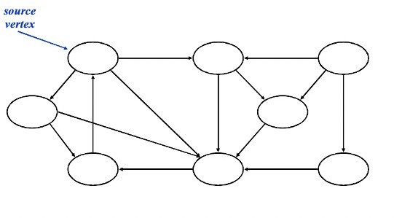
DFS - Example

Slide 5
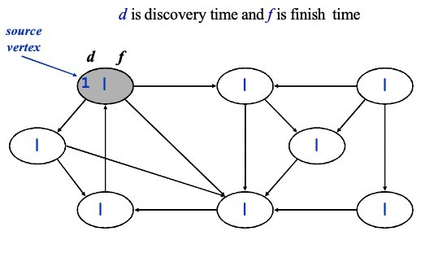
DFS - Example

Slide 6
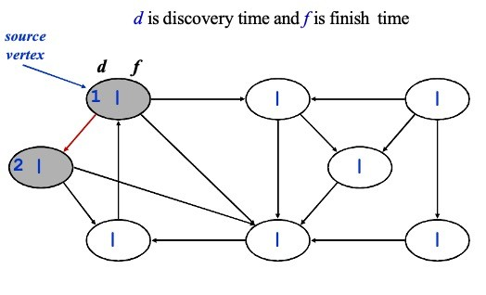
DFS - Example

Slide 7
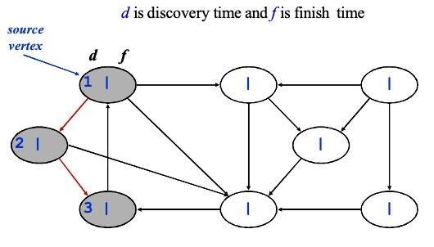
DFS - Example

Slide 8
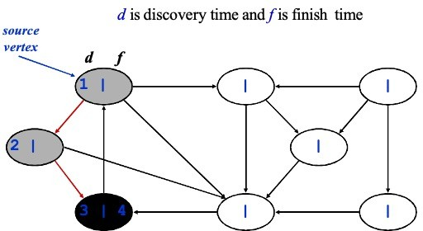
DFS - Example

Slide 9
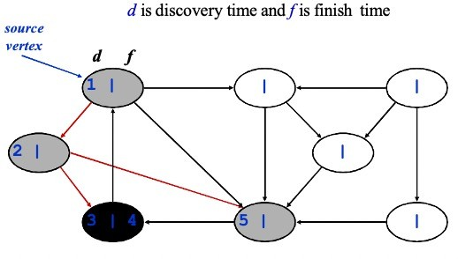
DFS - Example

Slide 10
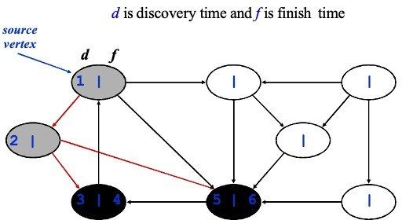
DFS - Example

Slide 11
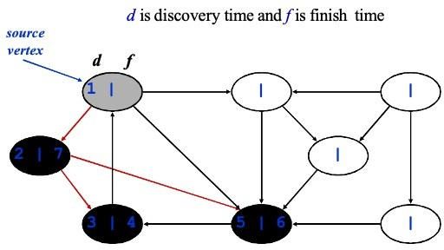
DFS - Example

Slide 12
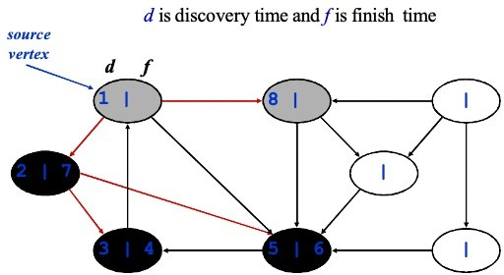
DFS - Example

Slide 13
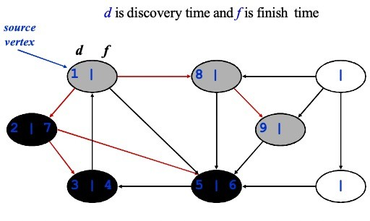
DFS - Example

Slide 14
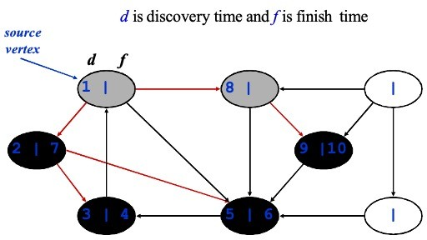
DFS - Example

Slide 15
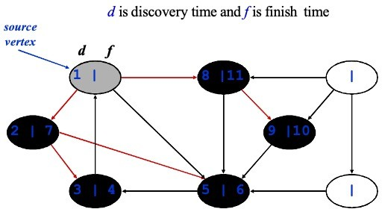
DFS - Example

Slide 16
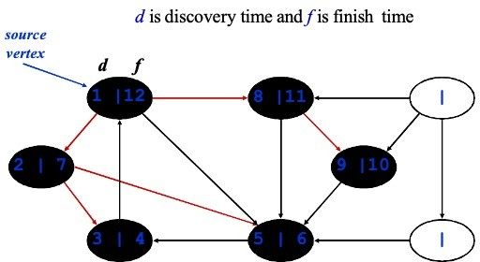
DFS - Example

Slide 17
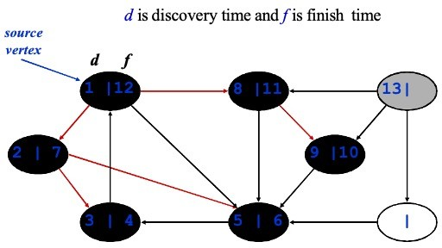
DFS - Example

Slide 18
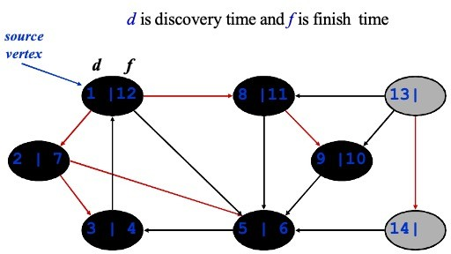
DFS - Example

Slide 19
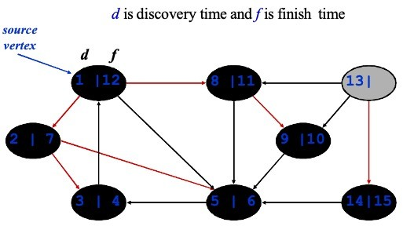
DFS - Example

Slide 20
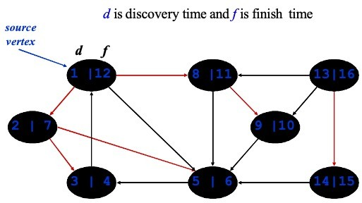
DFS - Example

Slide 21
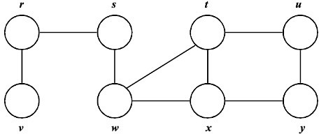
DFS – Example 2
Class activity – Try this one yourselves

Slide 22
DFS – Example 2
Sample Solution(Not only solution)
2|5
1|16
7|14
8|13
3|4
6|15
10|11
9|12

Slide 23
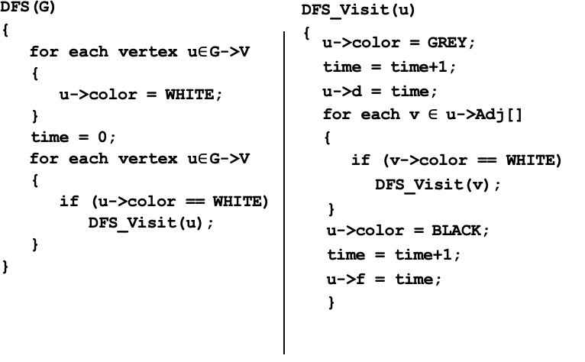
DFS – Code

Slide 24
DFS – Code

Slide 25
DFS – Code
Time Complexity?
O(V+E)

Slide 26
Topological Sort

Slide 27
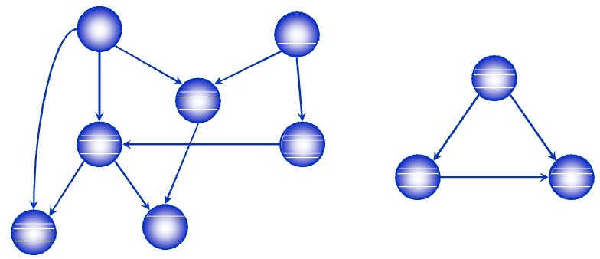
Directed Acyclic Graph
A directed acyclic graph or DAG is a directed graph with no directed cycles

Slide 28
Topological Sort
A topological sort of a DAG is
a linear ordering of all vertices of the graph G such that vertex u comes before vertex v if (u, v) is an edge in G.
DAG indicates precedence among events:
events are graph vertices, edge from u to v means event u has precedence over event v
Real-world example:
getting dressed
course registration
tasks for eating meal

Slide 29
Precedence Example
Tasks that have to be done to eat breakfast:
get glass, pour juice, get bowl, pour cereal, pour milk, get spoon, eat.
Certain events must happen in a certain order (ex: get bowl before pouring milk)
For other events, it doesn't matter (ex: get bowl and get spoon)

Slide 30
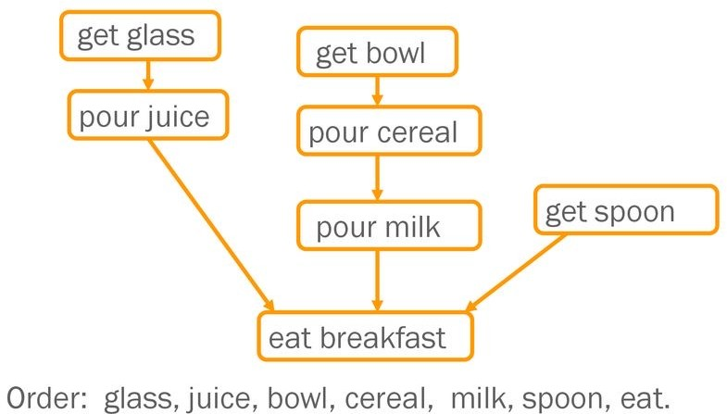
Precedence Example

Slide 31
Why Acyclic?
Why must directed graph by acyclic for the topological sort problem?
Otherwise, no way to order events linearly without violating a precedence constraint.

Slide 32

Topological Sort Algorithm
Time: O(V + E)
Correctness: Want to prove that (u, v) ∈ E(G) ⇒ f (u) > f (v)

Slide 33
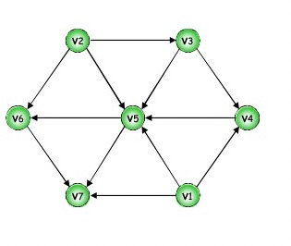
Topological Sort: Example

Slide 34
Topological Sort: Example
1|12
8|11
2|7
5|6
9|10
3|4
13|14
Topological Order: v1->v2->v3->v4->v5->v6->v7

Slide 35
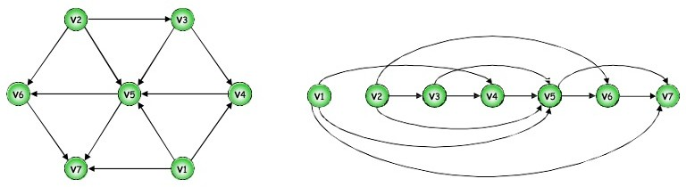
Topological Sort: Example
Topological Order: v1, v2, v3, v4, v5, v6, v7

Slide 36
Topological Sort: Using In Degree (Algorithm)
Steps for finding the topological ordering of a DAG:
Step-1: Compute in-degree for each of the vertices present in the DAG and initialize the count of visited nodes as 0;
Step-2: Add all vertices with in-degree equals 0 into a queue
Step-3: Remove a vertex from the queue and then Increment count of visited nodes by 1;
Decrease in-degree by 1 for all its neighboring nodes;
If in-degree of a neighboring node is reduced to zero, then add it to the queue;
Step 4: Repeat Step 3 until the queue is empty;
Step 5: If count of visited nodes is not equal to the number of nodes in the graph then the topological sort is not possible for the given graph.

Slide 37
Topological Sort: Using In Degree (Algorithm)
0 | 0 | 1 | 2 | 4 | 2 | 3
v1 | v2 | v3 | v4 | v5 | v6 | v7

Slide 38
Topological Sort: Using In Degree

Slide 39
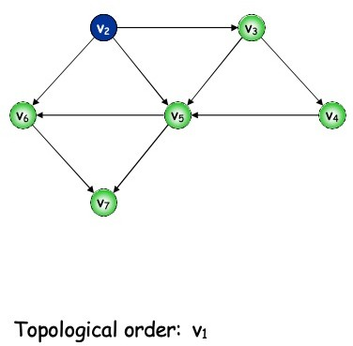
Topological Sort: Using In Degree

Slide 40
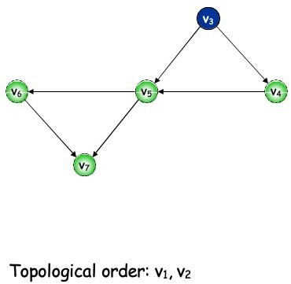
Topological Sort: Using In Degree

Slide 41
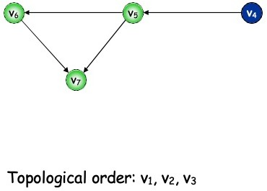
Topological Sort: Using In Degree

Slide 42
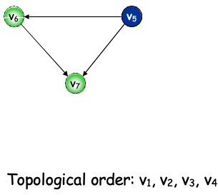
Topological Sort: Using In Degree

Slide 43
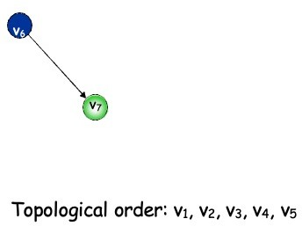
Topological Sort: Using In Degree

Slide 44
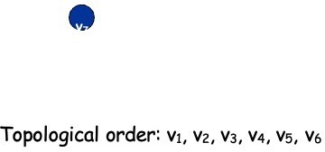
Topological Sort: Using In Degree

Slide 45
Topological Sort: Example
Topological Order: v1, v2, v3, v4, v5, v6, v7

Slide 46
When to use: BFS vs DFS
If we know a solution is not far from the root of the tree, BFS might be better.
If the tree is very deep and solutions are rare, DFS might take an extremely long time, but BFS could be faster.
If the tree is very wide, a BFS might need too much memory, so it might be completely impractical.
If solutions are frequent but located deep in the tree, DFS could be better.
If the search tree is very deep we will need to restrict the search depth for DFS (for example with iterative deepening).

Slide 47
Questions?

Slide 48
Thank you!

